Slide 1
8 Ball Champ New Rules

Slide 2
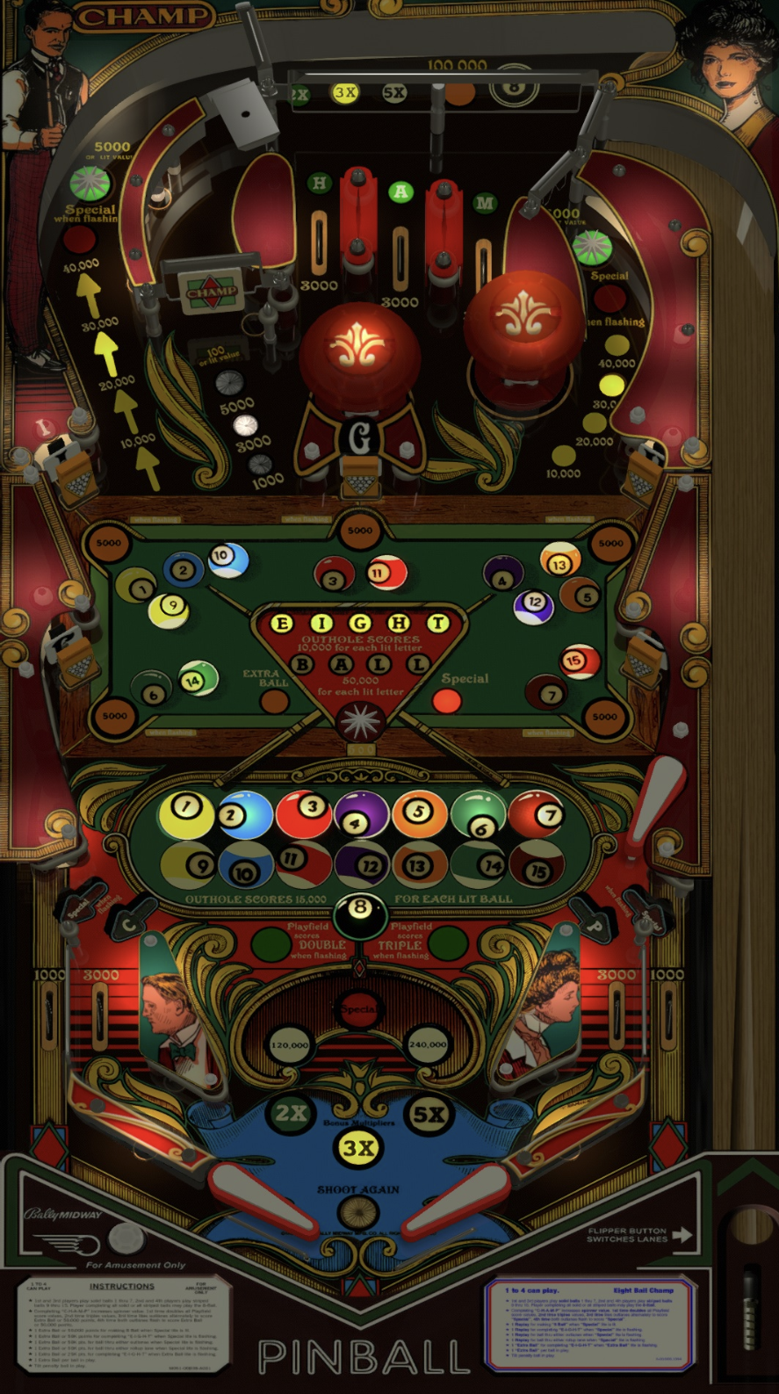
NEW collect value feature
Sinking a ball that hasn’t been sunk before activates collect feature (left orbit, spinner, right orbit) for a lit value. Once collected, it goes away and advances to the next collect
  They cycle starting from left, to spinner, to right and back again.
If a new ball is sunk and orbit/spinner not collected, do nothing – same collect stays lit.
Ball drain resets location of collect.
The idea here is to make the player alternate between shooting balls and hitting the collect values. This also forces the player to shoot all three sides – left orbit, spinner, right orbit, to keep the location moving to the most lucrative shot (the spinner – see next slides).

Slide 3
Spinner
Current Rules:
Awards lit value: 100 for unlit, 1000, 3000, 5000. Playfield multiplier currently does not affect how much each spin is worth (i.e. always at 1x playfield value).
Ball drain resets spinner back to unlit.

Slide 4
Spinner
New Rules:
Unlit spinner (i.e. collect feature not active) still worth 100
Spinner collect feature value starts at 1000
Spinner only lit when its ‘collect feature’ is activated (see slide #2 for description).
Collecting new E-I-G-H-T letter not yet awarded advances spinner: 3000, 4000, 5000, 6000, 8000, 9000 (basically a binary counter on the spinner).
Playfield multiplier affects the spinner (i.e. max spin can be 27,000 per spin).
Spinner is considered ‘collected’ if after a 2s delay after spinning, the spinner stops. This is akin to how Stern machine 2000 spinner values work on Stargazer or Quicksilver.
  After spinner is collected, advance collect feature to right orbit
Ball drain resets spinner collect feature value back to 1000.

Slide 5
Left Orbit & Hole
Current Rules:
Advances 10,000 each time rollover hit.
  Depending on settings, either keeps or resets on ball drain.
Hole advances Bonus 2x, 3x, 5x, and 100,000.
  100,000 multiplied by playfield value
  Bonus X and 100,000 reset on ball drain.

Slide 6
Left Orbit & Hole
New Rules Left Orbit:
Collects lit value when ‘collect feature’ active. Otherwise, whatever default score is (I think it’s 1,000 or 5,000).
C-H-A-M-P letters advance rollover value by 10,000.
  Depending on settings, either keeps or resets on ball drain.
Once collected, removes light. ‘collect feature’ advances to spinner.
New Rules Hole:
100,000 only lights if Bonus is past 5x AND left orbit collect feature activated.
Hole advances Bonus 2x, 3x, 5x, and 100,000.
  100,000 multiplied by playfield value, but will only be lit and collectable IF collect feature has been activated lit.
  If rollover collected, but 100,000 not collected, stays lit even if another collect has been activated.
Bonus X and 100,000 reset on ball drain.

Slide 7
Right Orbit
Current Rules:
Advances 10,000 each time rollover hit.
  Depending on settings, either keeps or resets on ball drain.
C-H-A-M-P letters also advance rollover value by 10,000.

Slide 8
Right Orbit
New Rules:
Collects lit value when ‘collect feature’ active.
  Depending on settings, either keeps or resets on ball drain.
  Value still synced with Left Orbit.
Once collected, removes light. ‘collect value feature’ advances to left orbit.
If unlit score default score is (I think it’s 1,000 or 5,000).

Slide 9
C-H-A-M-P feature
Current Rules:
Complete C-H-A-M-P once: 2x playfield, advance spinner to 1,000
Complete twice: 3x playfield, advance spinner to 3,000
Complete three times: advance spinner to 5,000
Additional completion: lights outlane specials
Ball drain keeps collected C-H-A-M-P letters

Slide 10
C-H-A-M-P feature
New Rules:
Each time C-H-A-M-P completed, advances the rollover score by 10,000
  Depending on settings, either keeps or resets on ball drain.
Completing C-H-A-M-P three times awards 2x playfield
Completing C-H-A-M-P six times awards 3x playfield
Completing C-H-A-M-P nine times lights specials at outlanes
Ball drain keeps collected C-H-A-M-P letters
Ball drain resets counter for 2x playfield / 3x playfield / special counter.
C-H-A-M-P no longer changes spinner value.

Slide 11
End

